Slide 1

20th November 2019

Slide 2
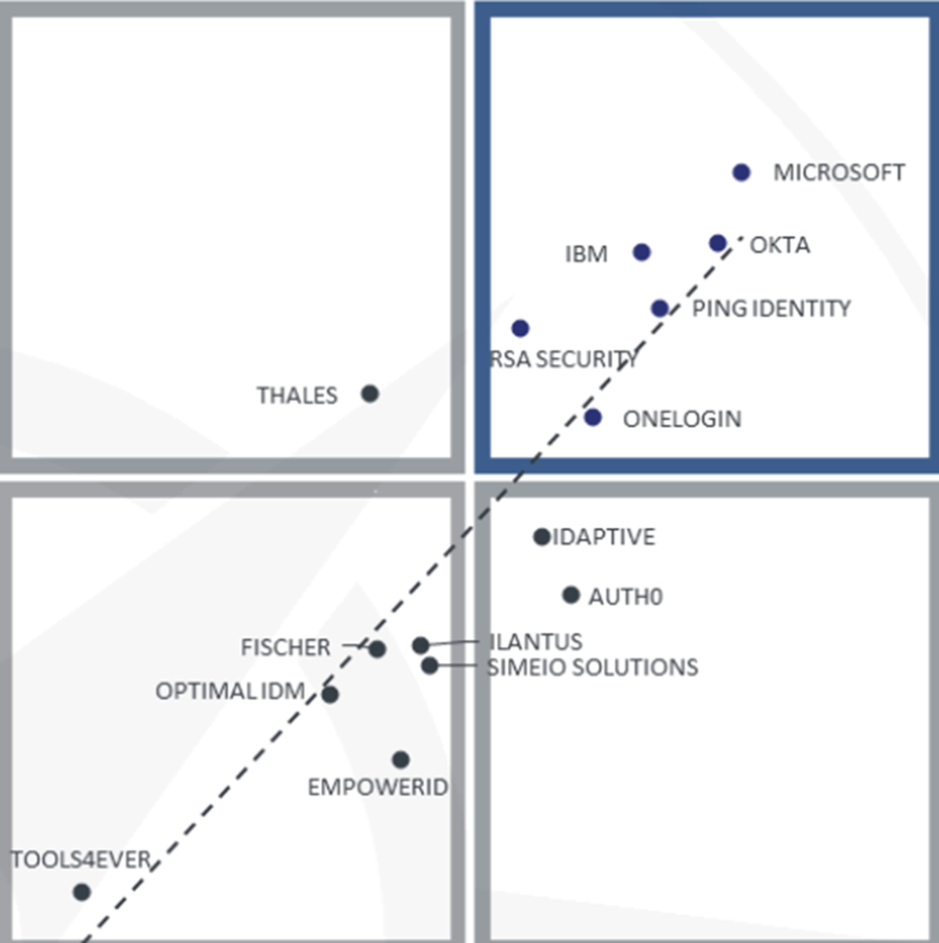
Rory – AAD & B2C
Notes:
1: Address compliance issues by running your workloads on hosts dedicated to your Azure Tenant. Normally when you provision a VM, its on a multi-tenanted host right. So with other Azure customers workloads.
2: You can provision a host group and add dedicated hosts to it within a region or even an availability zone. Same applies for fault domains, so different racks, power etc within an Azure DC.
3: Windows Server Datacenter licenses and Software Assurance can use unlimited virtualization rights in Azure Dedicated Hosts.
4: Allows you to control the maintenance of your dedicated hosts – You currently have to apply to try this preview feature and can defer up to 35day before your forced to apply the maintenance.
5: A current limitation is your can only provision workloads from a particular VM family. You pick which one when you provision: ESv2 or DSv3.

Slide 3
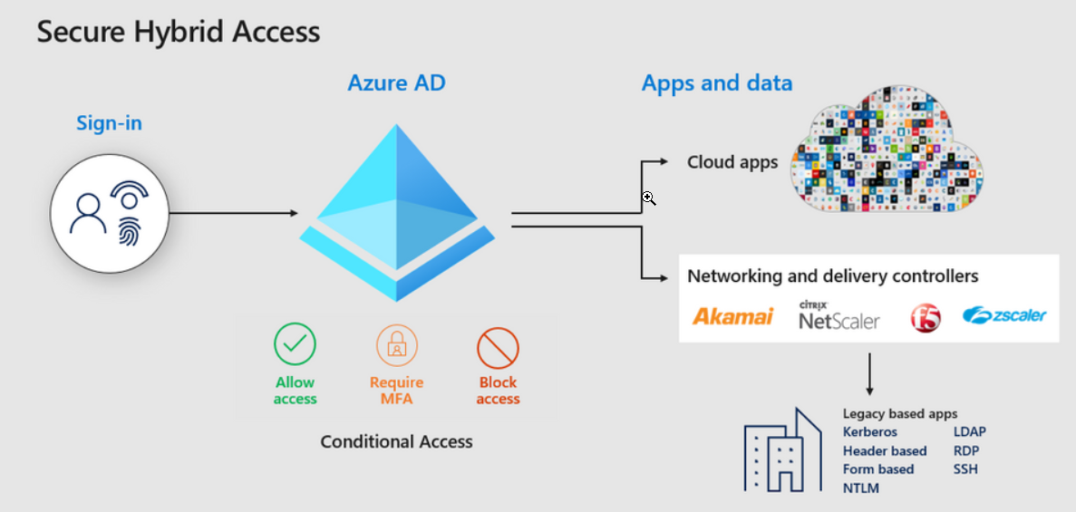
Rory – AAD & B2C
Notes:
1: Address compliance issues by running your workloads on hosts dedicated to your Azure Tenant. Normally when you provision a VM, its on a multi-tenanted host right. So with other Azure customers workloads.
2: You can provision a host group and add dedicated hosts to it within a region or even an availability zone. Same applies for fault domains, so different racks, power etc within an Azure DC.
3: Windows Server Datacenter licenses and Software Assurance can use unlimited virtualization rights in Azure Dedicated Hosts.
4: Allows you to control the maintenance of your dedicated hosts – You currently have to apply to try this preview feature and can defer up to 35day before your forced to apply the maintenance.
5: A current limitation is your can only provision workloads from a particular VM family. You pick which one when you provision: ESv2 or DSv3.

Slide 4
Rory – AAD & B2C
All customers can now enable MFA for free with the Microsoft Authenticator app.
Conditional Access report-only mode is now in public preview. It allows administrators to evaluate potential impact of new policies before rolling them out across the entire organization
The Global Reader role along with 15 other roles rolled out in public preview last month for further visibility into settings and policies without added risk.
Azure AD entitlement management is now generally available!
Public preview of inbound user provisioning from SAP SuccessFactors
Staged rollout to cloud authentication is now available in public preview
Firstline Worker – log in with phone number and code
Notes:
1: Address compliance issues by running your workloads on hosts dedicated to your Azure Tenant. Normally when you provision a VM, its on a multi-tenanted host right. So with other Azure customers workloads.
2: You can provision a host group and add dedicated hosts to it within a region or even an availability zone. Same applies for fault domains, so different racks, power etc within an Azure DC.
3: Windows Server Datacenter licenses and Software Assurance can use unlimited virtualization rights in Azure Dedicated Hosts.
4: Allows you to control the maintenance of your dedicated hosts – You currently have to apply to try this preview feature and can defer up to 35day before your forced to apply the maintenance.
5: A current limitation is your can only provision workloads from a particular VM family. You pick which one when you provision: ESv2 or DSv3.

Slide 5
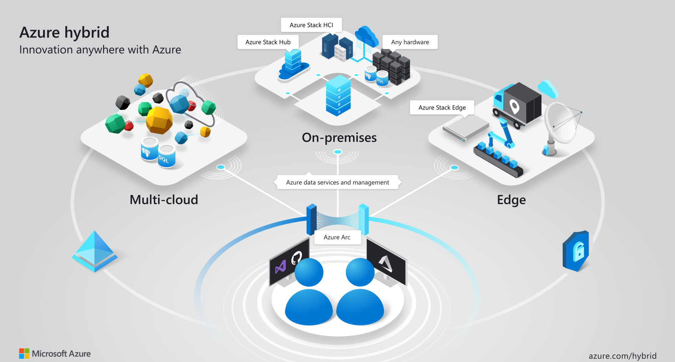

Slide 6
BUDDY – Azure ARC
GET TYPING BUDDY!

Slide 7
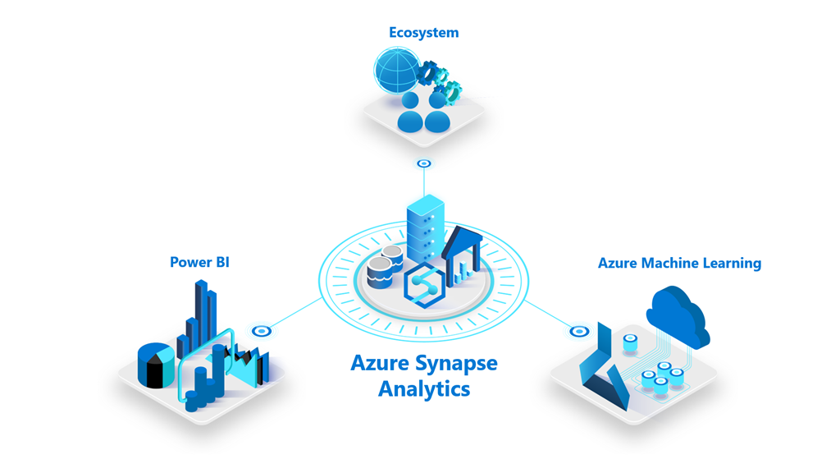
Dave – Azure Synapse
Notes:
1: Address compliance issues by running your workloads on hosts dedicated to your Azure Tenant. Normally when you provision a VM, its on a multi-tenanted host right. So with other Azure customers workloads.
2: You can provision a host group and add dedicated hosts to it within a region or even an availability zone. Same applies for fault domains, so different racks, power etc within an Azure DC.
3: Windows Server Datacenter licenses and Software Assurance can use unlimited virtualization rights in Azure Dedicated Hosts.
4: Allows you to control the maintenance of your dedicated hosts – You currently have to apply to try this preview feature and can defer up to 35day before your forced to apply the maintenance.
5: A current limitation is your can only provision workloads from a particular VM family. You pick which one when you provision: ESv2 or DSv3.

Slide 8
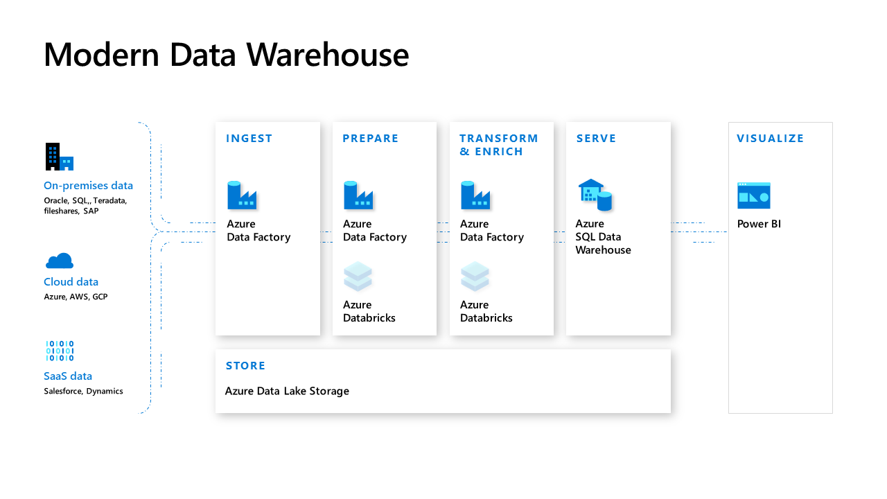
Modern Azure Analytics Platforms
Azure Data Factory
Azure Data Lake
Azure Databricks
Azure SQL / SQLDW
Azure Data Catalogue

Slide 9
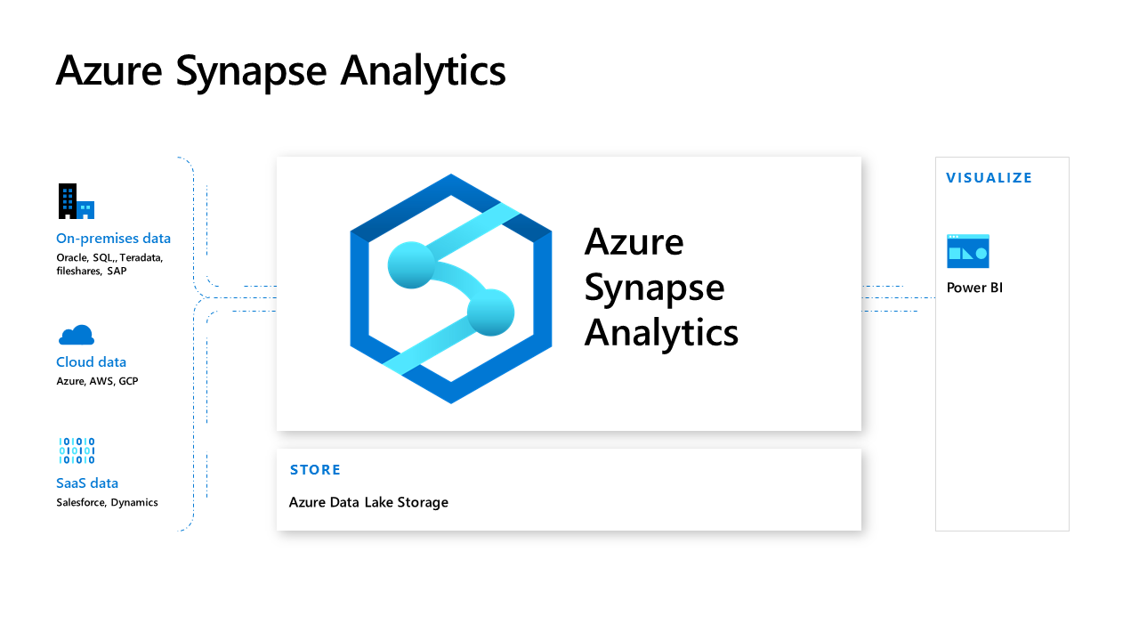
Evolution of Azure Data Warehouse
Azure Synapse
Azure Data Lake

Slide 10
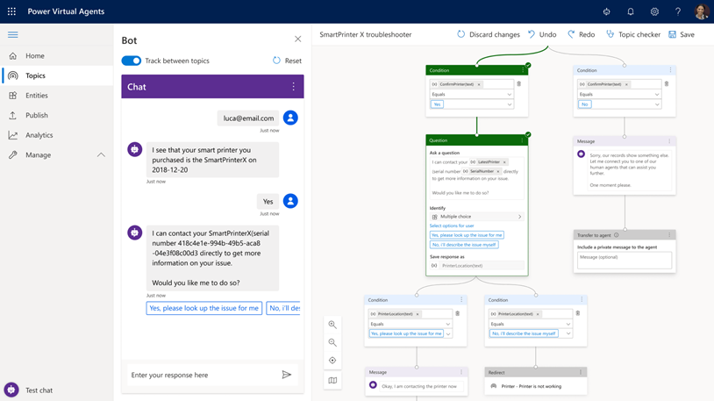
Alessandro – Microsoft Power Virtual Agents
Notes:
1: Address compliance issues by running your workloads on hosts dedicated to your Azure Tenant. Normally when you provision a VM, its on a multi-tenanted host right. So with other Azure customers workloads.
2: You can provision a host group and add dedicated hosts to it within a region or even an availability zone. Same applies for fault domains, so different racks, power etc within an Azure DC.
3: Windows Server Datacenter licenses and Software Assurance can use unlimited virtualization rights in Azure Dedicated Hosts.
4: Allows you to control the maintenance of your dedicated hosts – You currently have to apply to try this preview feature and can defer up to 35day before your forced to apply the maintenance.
5: A current limitation is your can only provision workloads from a particular VM family. You pick which one when you provision: ESv2 or DSv3.

Slide 11
Highlights
Get started in seconds
Empower your subject matter experts
Enable rich, natural conversations
Enable bots to take action
Microsoft Flow integration
Monitor and improve bot performance

Slide 12
Demo
Brazil Bot

Slide 13
Aben: Top Ten Security Practices on Azure
LORUM IPSUM!!
Notes:
1: Address compliance issues by running your workloads on hosts dedicated to your Azure Tenant. Normally when you provision a VM, its on a multi-tenanted host right. So with other Azure customers workloads.
2: You can provision a host group and add dedicated hosts to it within a region or even an availability zone. Same applies for fault domains, so different racks, power etc within an Azure DC.
3: Windows Server Datacenter licenses and Software Assurance can use unlimited virtualization rights in Azure Dedicated Hosts.
4: Allows you to control the maintenance of your dedicated hosts – You currently have to apply to try this preview feature and can defer up to 35day before your forced to apply the maintenance.
5: A current limitation is your can only provision workloads from a particular VM family. You pick which one when you provision: ESv2 or DSv3.

Slide 14
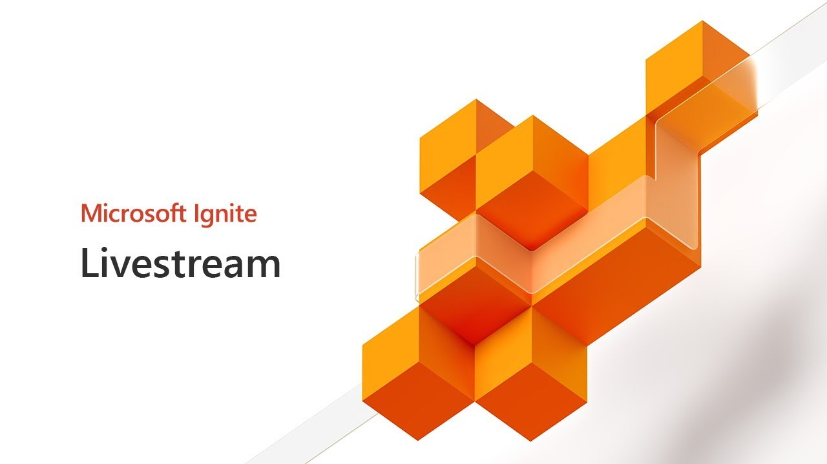
Wagner Silveira API Management Arc Enabled
Wagner Silveira

Slide 15
API management Arc Enabled
What it is?
Self Hosted API Gateway
Container Based
Supports Docker and Kubernetes Deployments
Control Plane in Azure (Arc)

Slide 16
API Management Arc Enabled
Features
Pick and choose the APIs to deploy
Custom Domains
Custom “Region”
Sync with control plane when connected
Works even without Connection to Azure
Notes:
Event Grid on IoT Edge is now available in preview, allowing customers to adopt event-driven architectures on solutions created for disconnected environments or hybrid setups, bringing a powerful cloud application pattern to the edge. Using containers, the solution enables the pub-sub semantics available in Azure to work between modules within the same edge device and also between edge devices for disconnected environments, as well as sending events from the edge to the cloud for hybrid solutions.

Slide 17

Hands on time!

Slide 18
Sudhir: Mapping Dataflow in ADF
LORUM IPSUM!!
Notes:
1: Address compliance issues by running your workloads on hosts dedicated to your Azure Tenant. Normally when you provision a VM, its on a multi-tenanted host right. So with other Azure customers workloads.
2: You can provision a host group and add dedicated hosts to it within a region or even an availability zone. Same applies for fault domains, so different racks, power etc within an Azure DC.
3: Windows Server Datacenter licenses and Software Assurance can use unlimited virtualization rights in Azure Dedicated Hosts.
4: Allows you to control the maintenance of your dedicated hosts – You currently have to apply to try this preview feature and can defer up to 35day before your forced to apply the maintenance.
5: A current limitation is your can only provision workloads from a particular VM family. You pick which one when you provision: ESv2 or DSv3.

Slide 19
Jaliya: Visual Studio Online
LORUM IPSUM!!
Notes:
1: Address compliance issues by running your workloads on hosts dedicated to your Azure Tenant. Normally when you provision a VM, its on a multi-tenanted host right. So with other Azure customers workloads.
2: You can provision a host group and add dedicated hosts to it within a region or even an availability zone. Same applies for fault domains, so different racks, power etc within an Azure DC.
3: Windows Server Datacenter licenses and Software Assurance can use unlimited virtualization rights in Azure Dedicated Hosts.
4: Allows you to control the maintenance of your dedicated hosts – You currently have to apply to try this preview feature and can defer up to 35day before your forced to apply the maintenance.
5: A current limitation is your can only provision workloads from a particular VM family. You pick which one when you provision: ESv2 or DSv3.

Slide 20



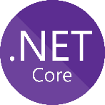
DSR: Azure Functions (if needed)
Azure Functions Premium GA
No cold start - pre-warmed instances
VNET integration
More powerful, customizable instances
Python 3.7 Support
.NET Core 3 support (Preview)
PowerShell Core in Azure Functions GA
Use existing PowerShell scripts/techniques/skills
Timer, HTTP & many more Azure Triggers
Can use PowerShell Gallery Modules
Very cheap (even free)
Integrate to ITIL, Power platform (MS Teams)
Supports authentication via Azure AD

Slide 21
DSR: Azure Functions (if needed)
Demo
PowerShell Core in Functions
Cleaning up Temporary Resource Groups on a Schedule
Idea shamelessly stolen from @JeffHollan

Slide 22
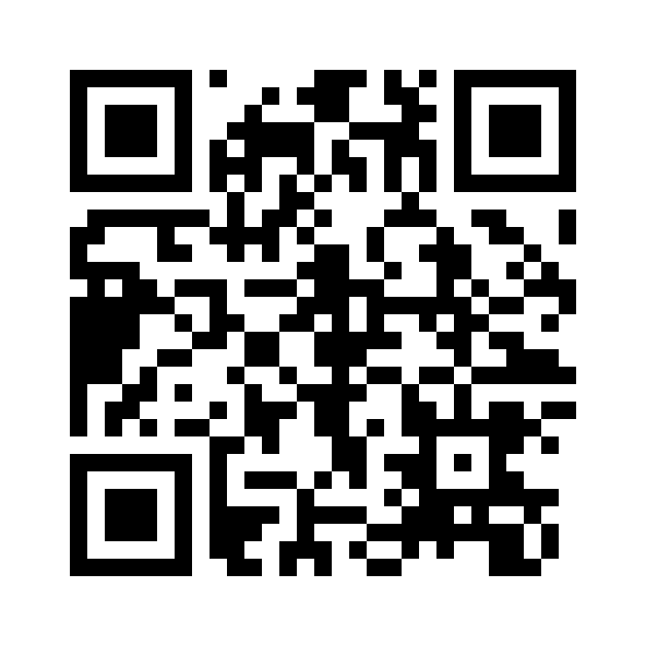
Slide Pack
20th November 2019
https://aka.ms/aaug

Slide 23
Some other Azure User Groups
Some other places to get your fix of Azure and Ignite!
Hamilton Azure User Group
Mini Ignite - Final Azure Meetup for 2019: Tuesday, November 26, 2019 4:30 PM – 6:30 PM @ SkyCity Hamilton
https://www.meetup.com/Hamilton-Microsoft-Azure-Meetup-Group
Azure Lunchtime Meetup
Microsoft Ignite 2019 - Lightning Talks: Monday, December 9, 2019 11:30 AM-1:30 PM @ Microsoft NZ
https://www.meetup.com/Auckland-Azure-Lunchtime-Meetup/events/266376036/

Slide 24
THE YEAR THAT WAS 2019
Notes:
That’s it, the last session of the year. I feel like its been a good one – Some new content topic saround IoT, integration, Express Route, Front Door sneak peeks, a LOT of governance talks and of course Kos from MSFT with his loose ask me anything no filter greatness last month!

Slide 25





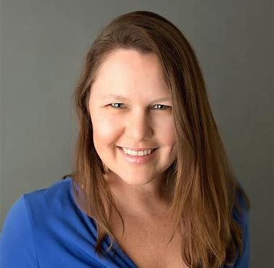








Changing Of The Guard & Fresh Speakers
Notes:
One of the biggest things for us this year has been seeing some new faces get involved in speaking, organising, setting up and just generally being apart of the community.
For myself, Rory, Dan, Aben and the others we put these meetups on not just for us to present session or for our benefit
But for you guys and seeing new faces in the audience, having good yarns over beer and pizza
Getting fresh speakers stepping up to present is just really awesome!
So 2020 that is something we really want to keep pushing on.

Slide 26
Global Azure Bootcamp 2019
EMBED Videos!
Notes:
The bootcamp this year was a tough one to organize, we had to source new venues, fresh sponsors, fill more sessions with speakers and find merch!
Luckily we managed to do all that and learn a whole bunch about organising something of that scale along the way. Hopefully, we get to have the opportunity again next to run it here in AKL and hopefully some other similar events throughout the year as well with some help from Microsoft.

Slide 27
THE YEAR THAT WILL BE 2020
Notes:
Is largely TBC – We will aim to run the first meetup back in January or Feb depending on peoples movements.
But between now and then keep an eye open for some comms on meetup / Twitter for general news & happenings. Potentially some polls may go out to get some input from you guys on topics to start the year off with.
So other than that, have a great December, Christmas & New Year. We will hopefully see you guys in 2020.

